Slide 1

ANGULAR PROJECT
Presented by
Nidhi R Shetty

Slide 2

Problem Statement
FitPro Inc provides an Online Solution about Dietary plans, Nutritional Values, Fitness Suggestions and Solutions. They want their solution to be a web based solution as well as accessible on Mobile Apps. This Particular Solution We focus only on Web Based SolutionA Single page App need to be built with multiple Flows.
There are two kinds of users for the app:
People belonging to
a. User group
b. Admin Group

Slide 3
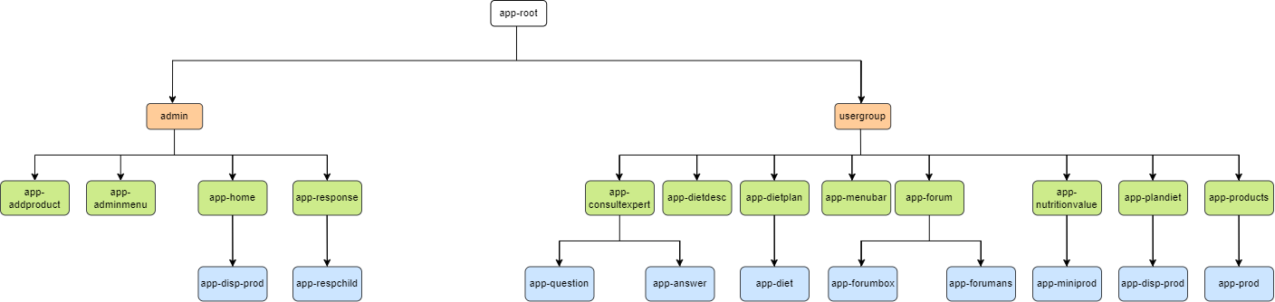
IMPLEMENTATION DESIGN APPROACH

Slide 4
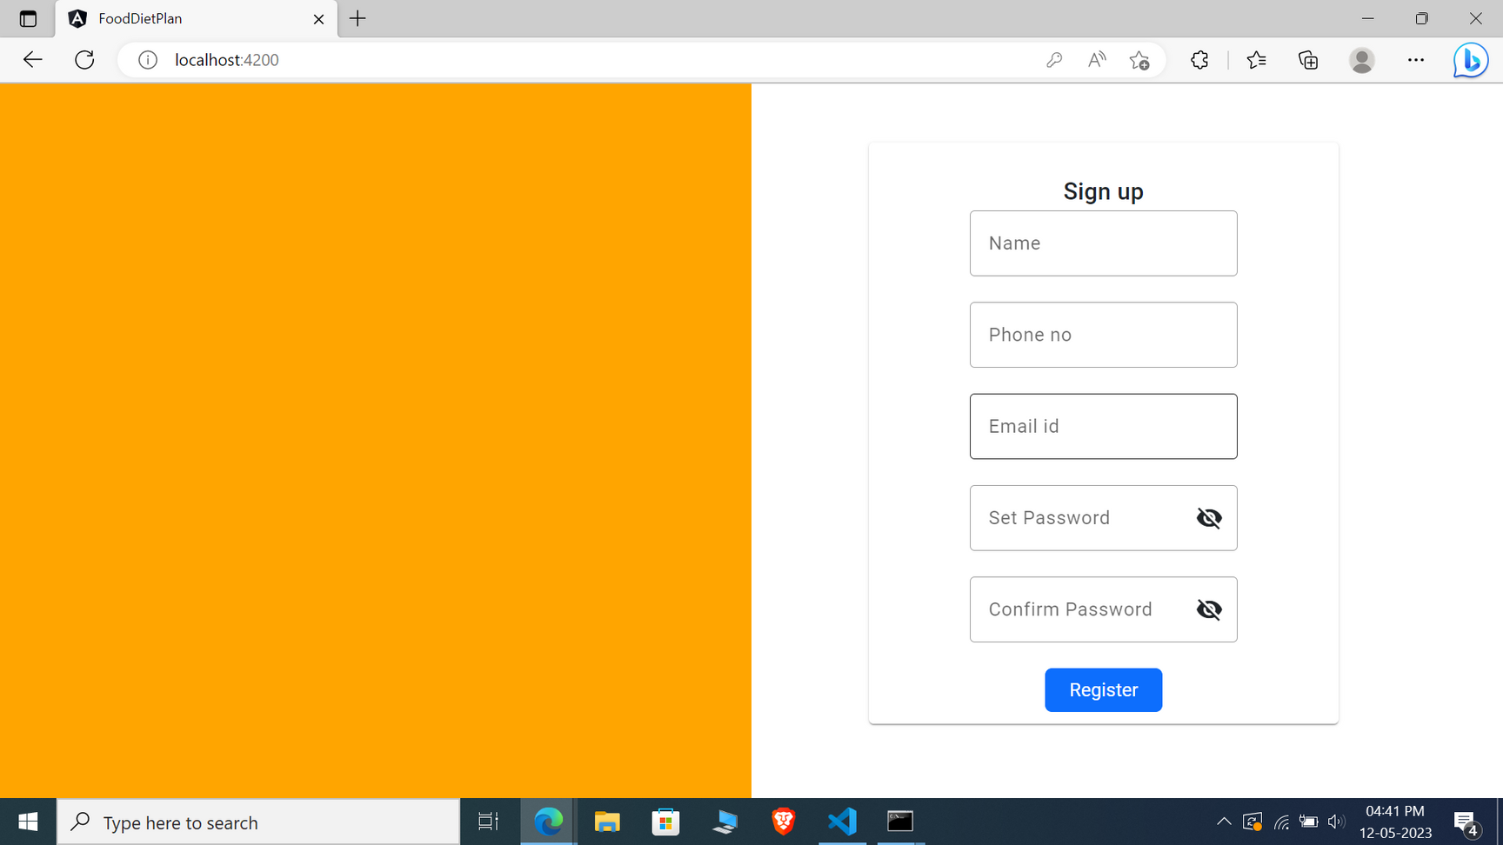
USER REGISTRATION

Slide 5
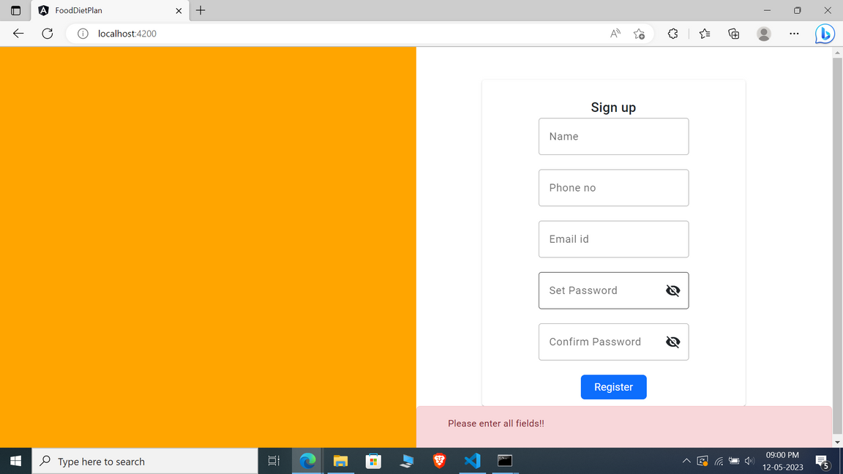
REGISTRATION PAGE VALIDATION

Slide 6
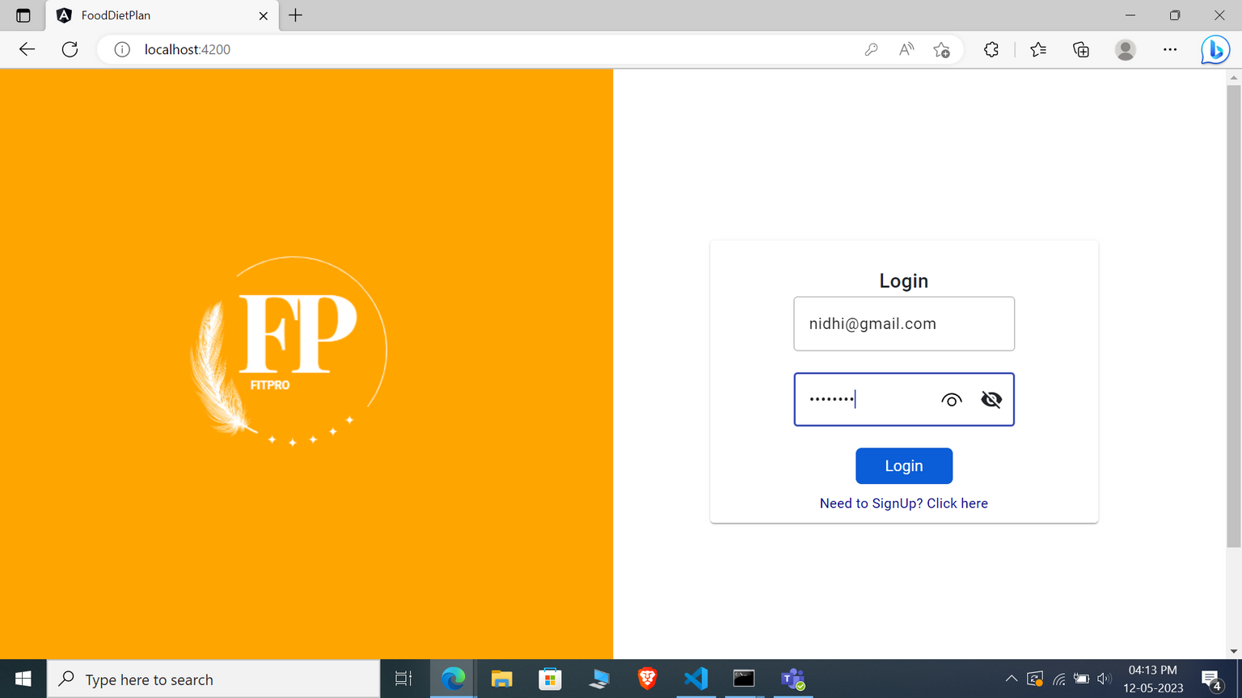
USER LOGIN

Slide 7
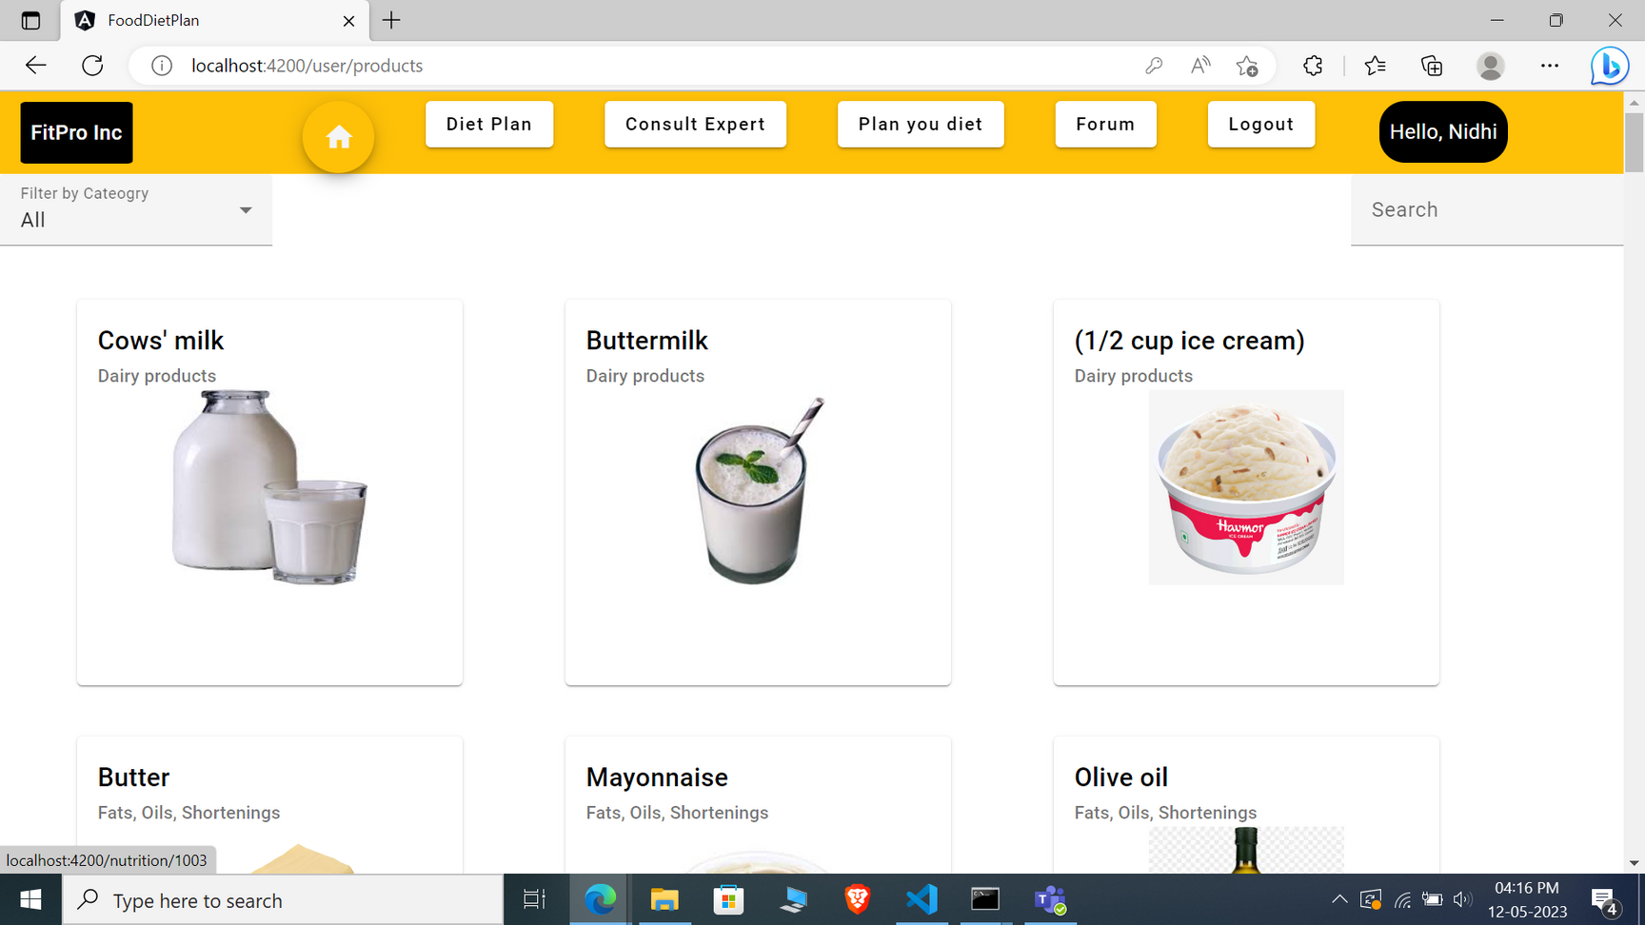
USER HOME PAGE

Slide 8
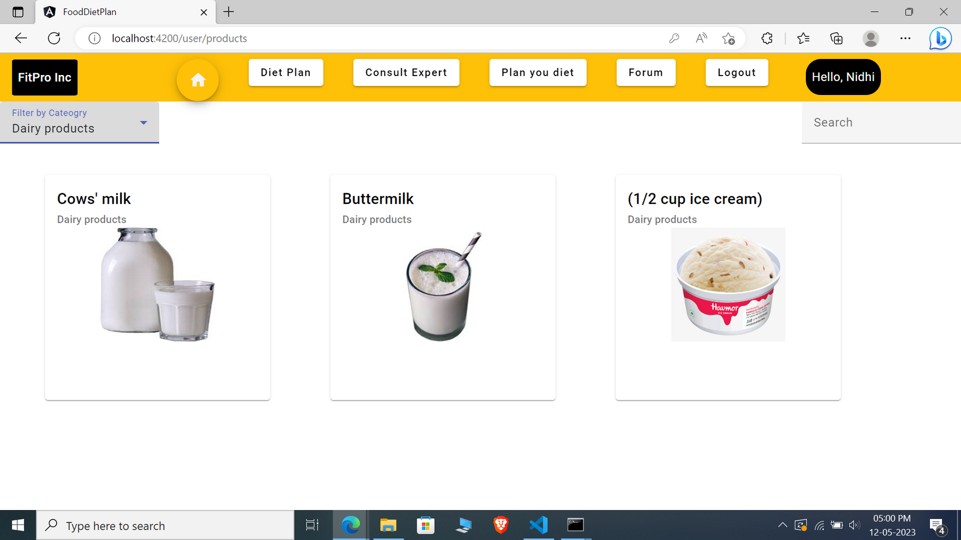
Users can filter the products based on category

Slide 9
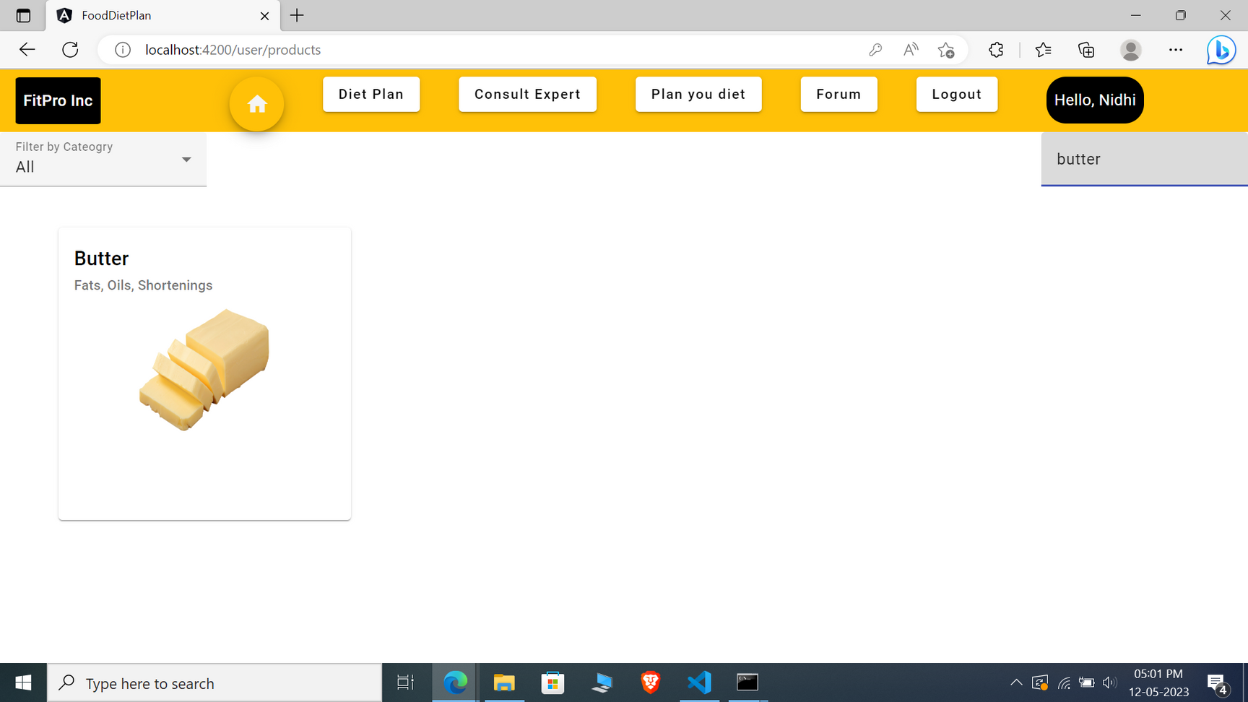
Users can search products using search bar

Slide 10
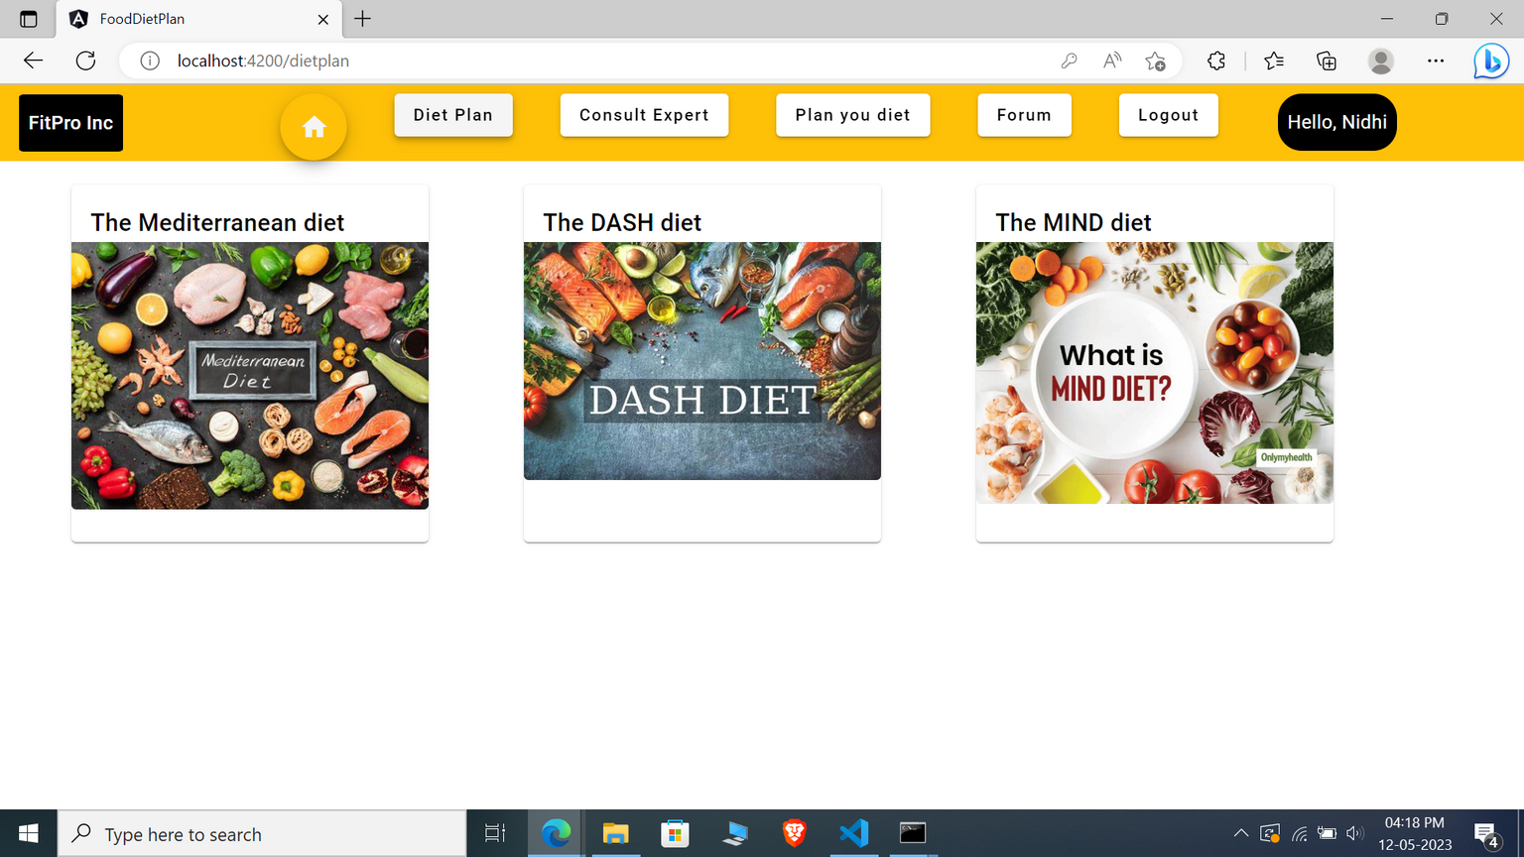
VIEW CUSTOMIZED DIET PLAN

Slide 11
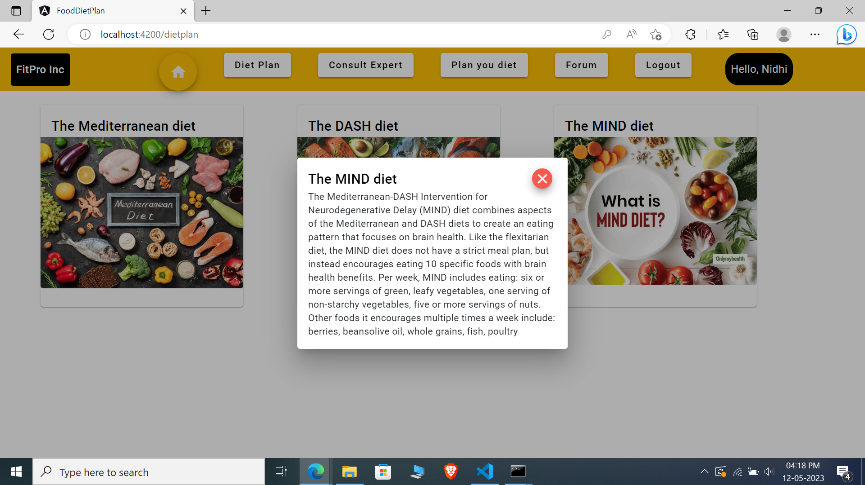

Slide 12
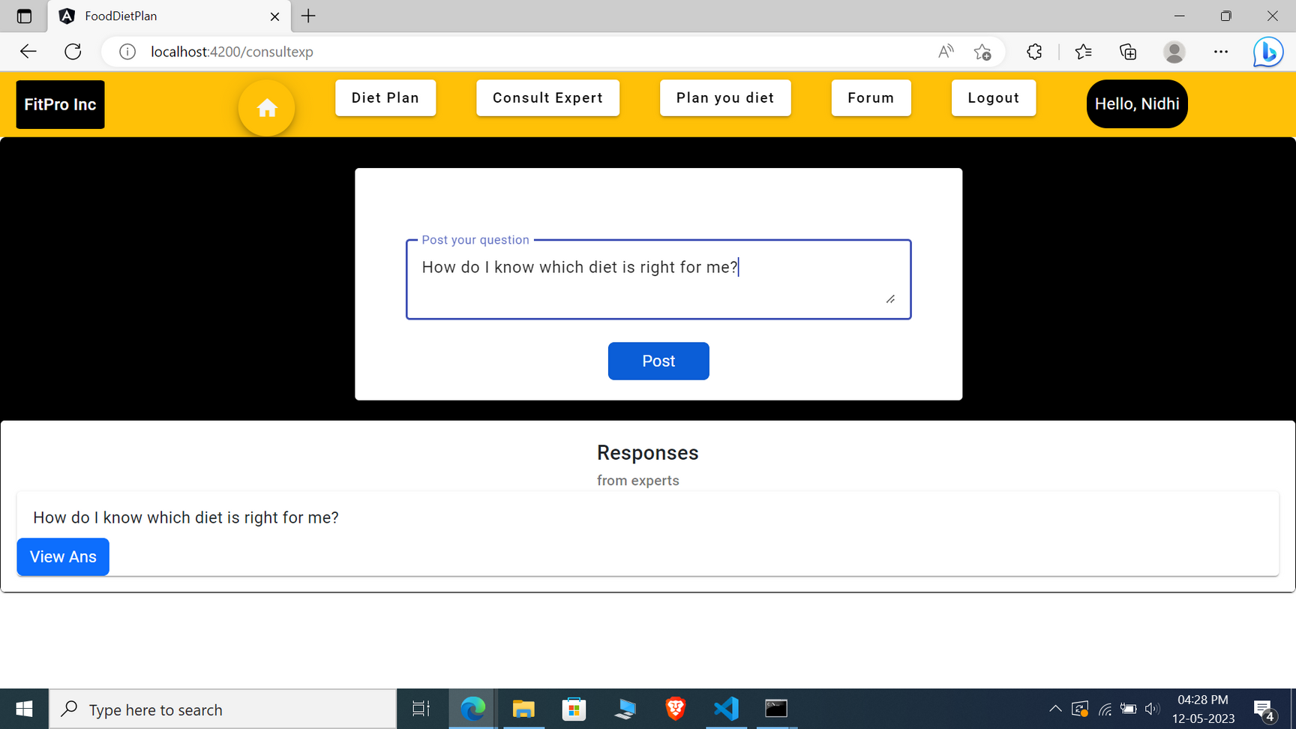
CONSULT EXPERT
Users can post questions to user and the questions will be displayed below

Slide 13
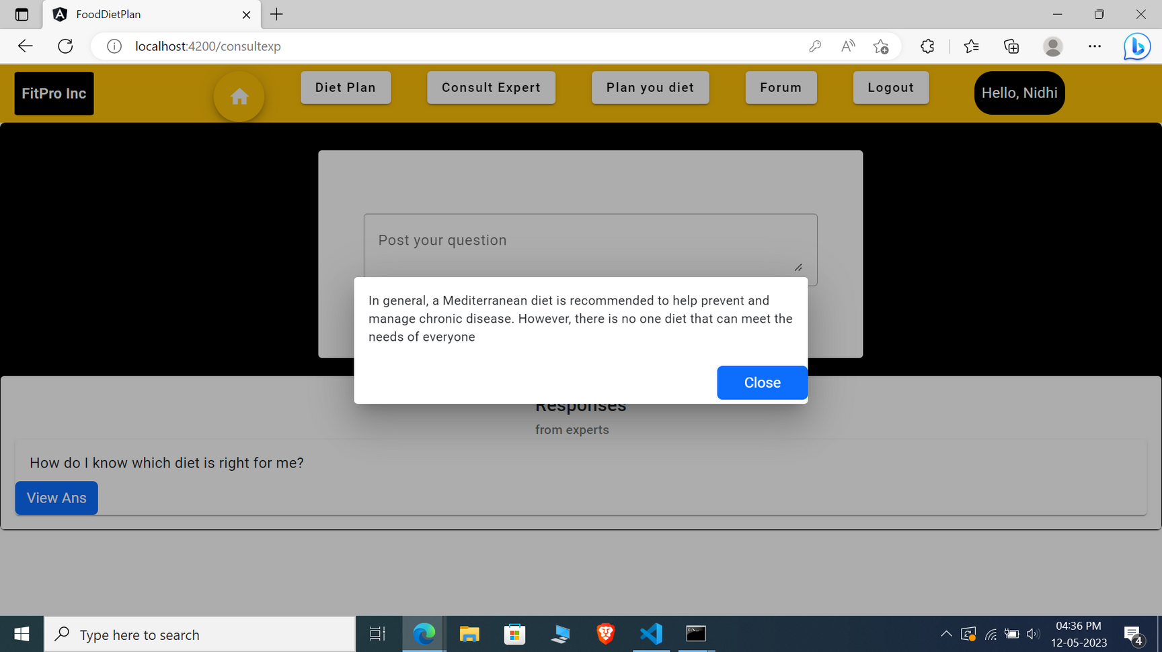
Answers posted by admin for a particular question will be displayed on clikcing "View Ans"

Slide 14
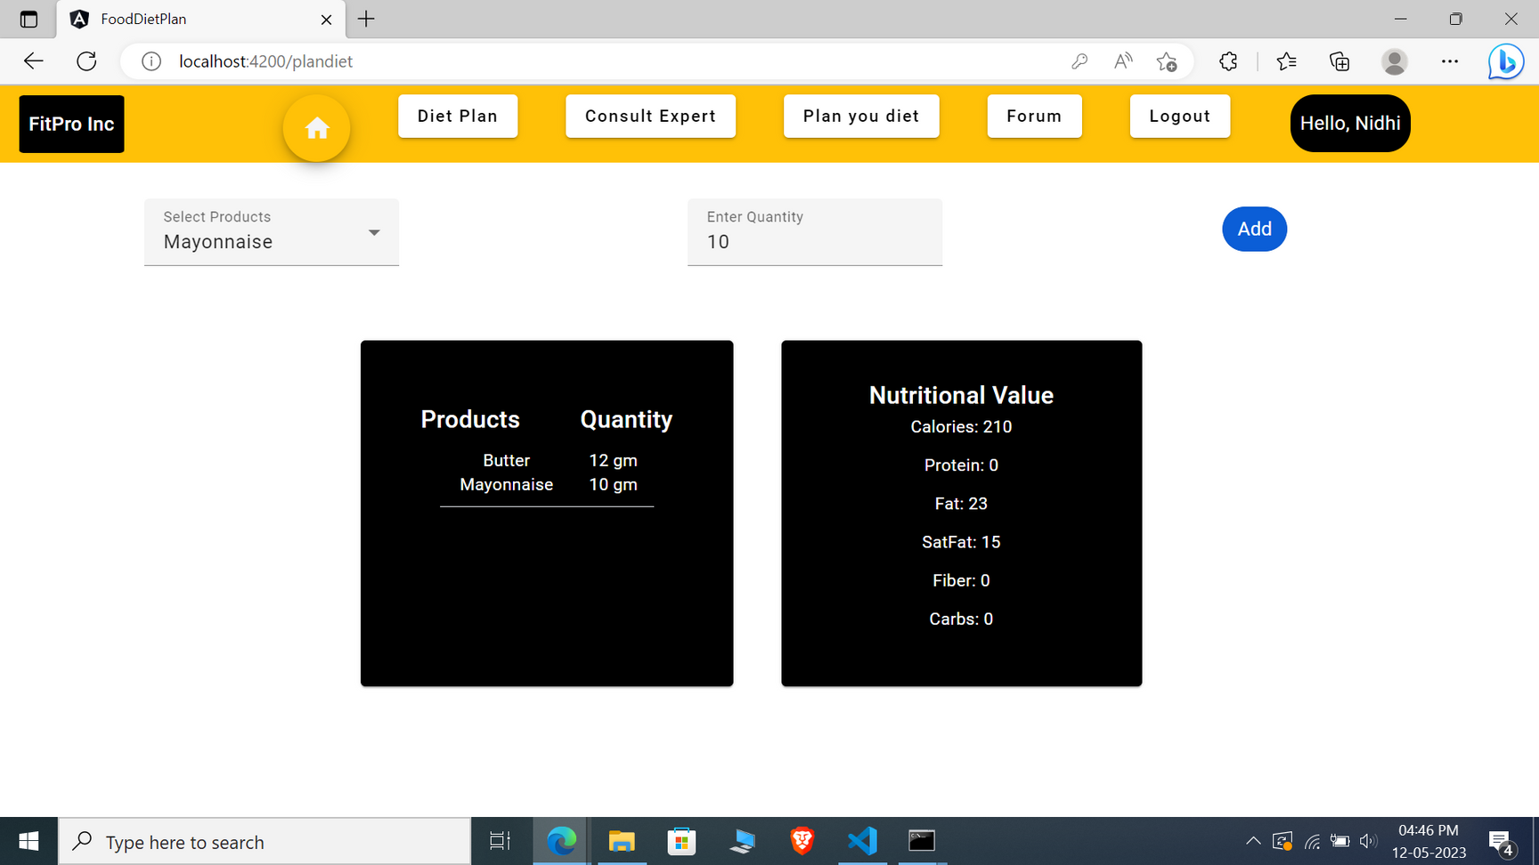
PLAN YOUR DIET

Slide 15
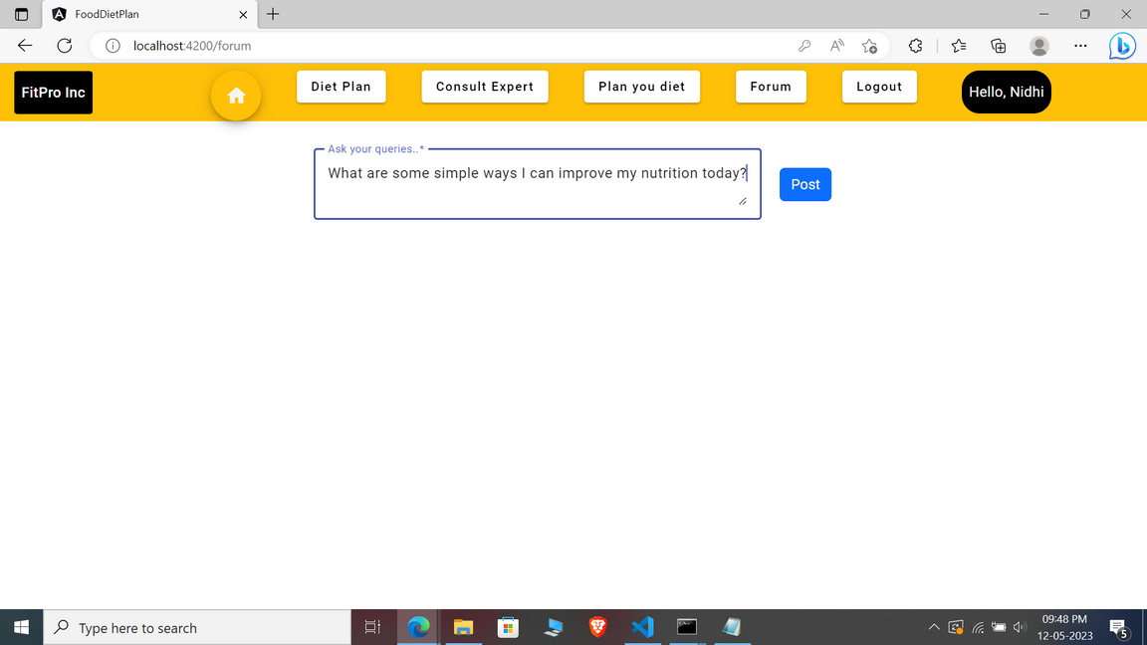
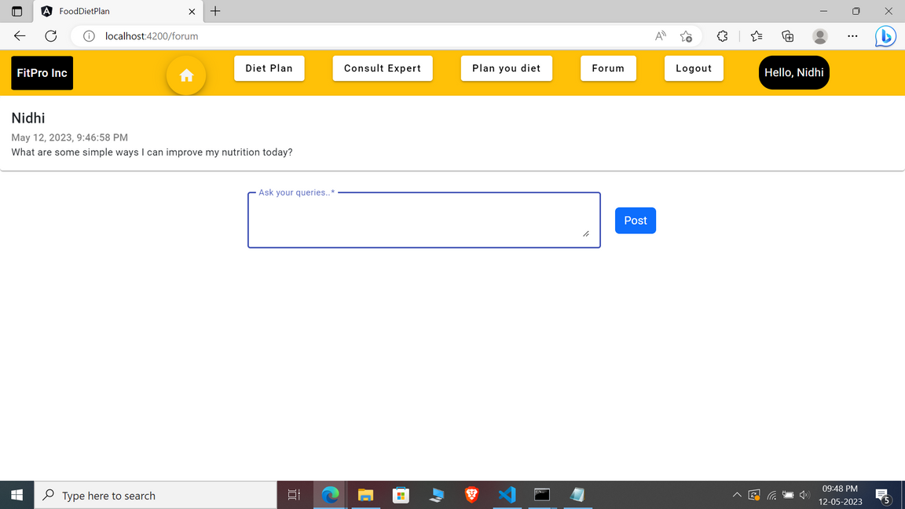
FORUM PAGE
In the forum page, any user can post their queries and also can answer to other user's queries

Slide 16
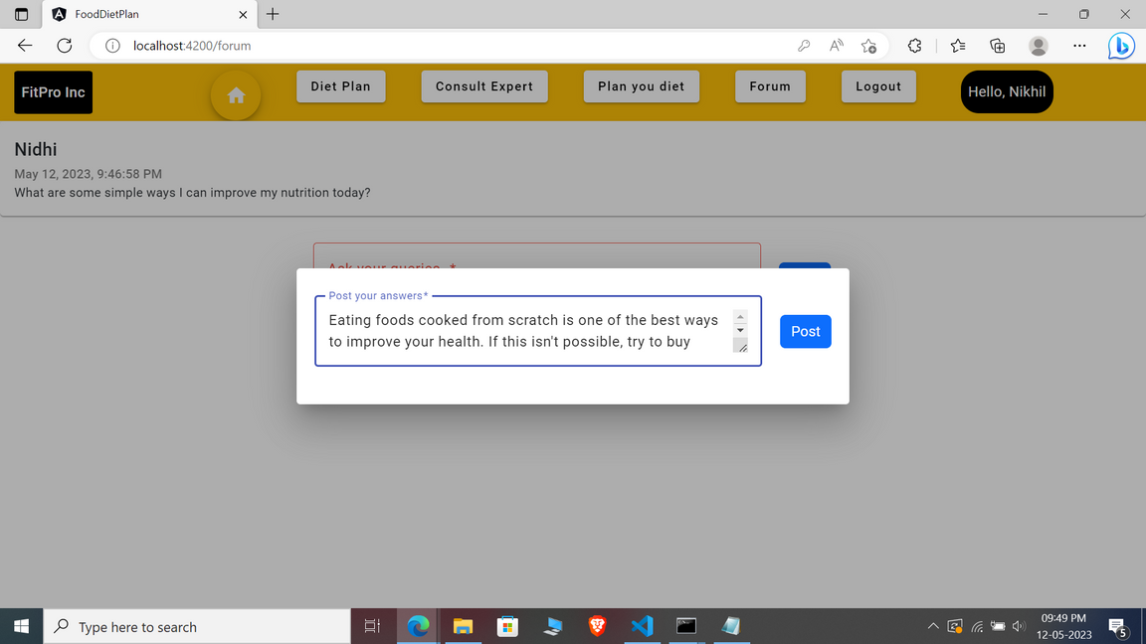
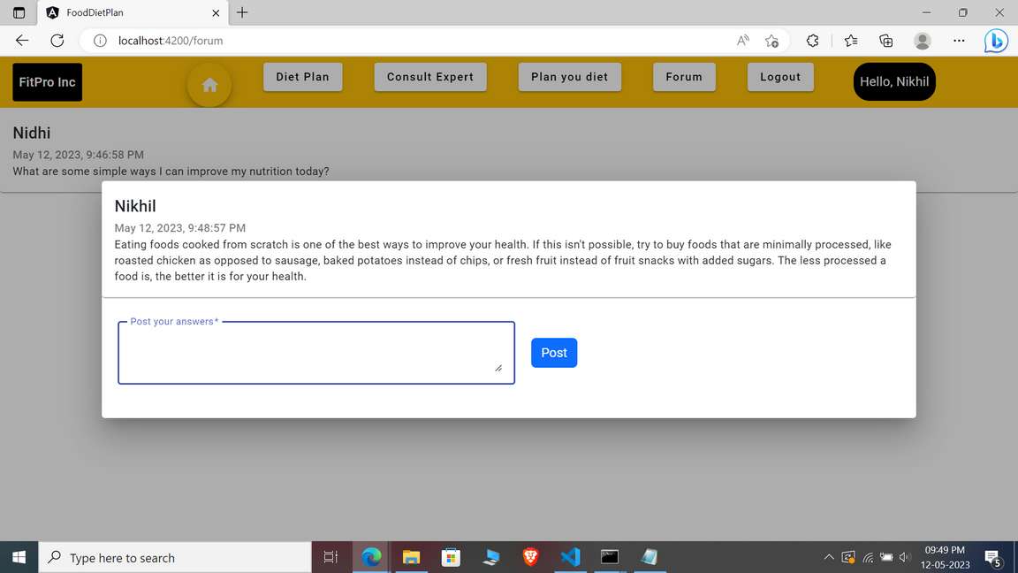
This is where user's can post answers to other user's queries

Slide 17

ADMIN LOGIN

Slide 18
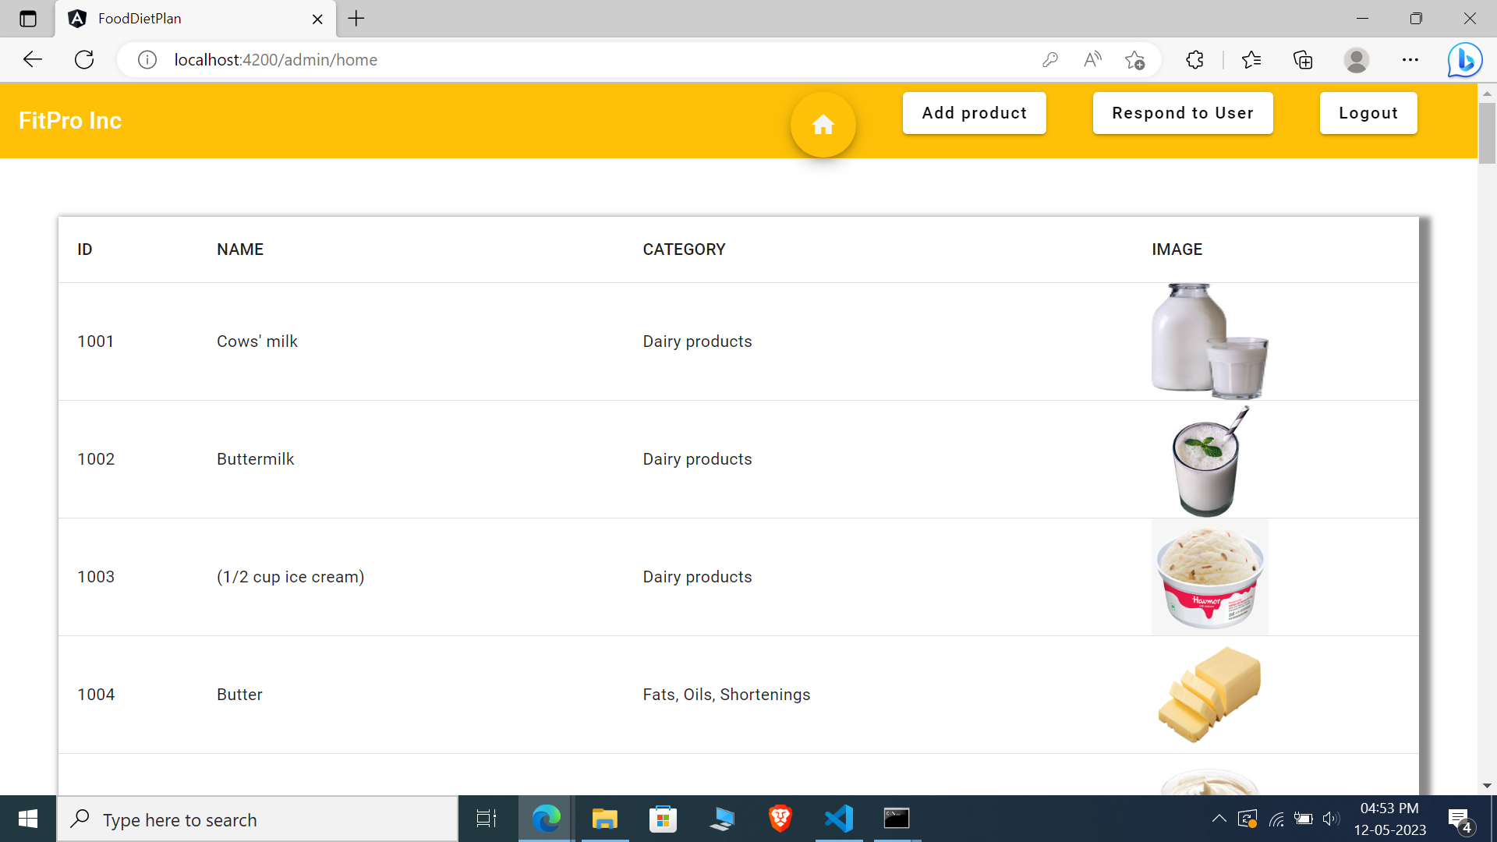
ADMIN HOME PAGE

Slide 19
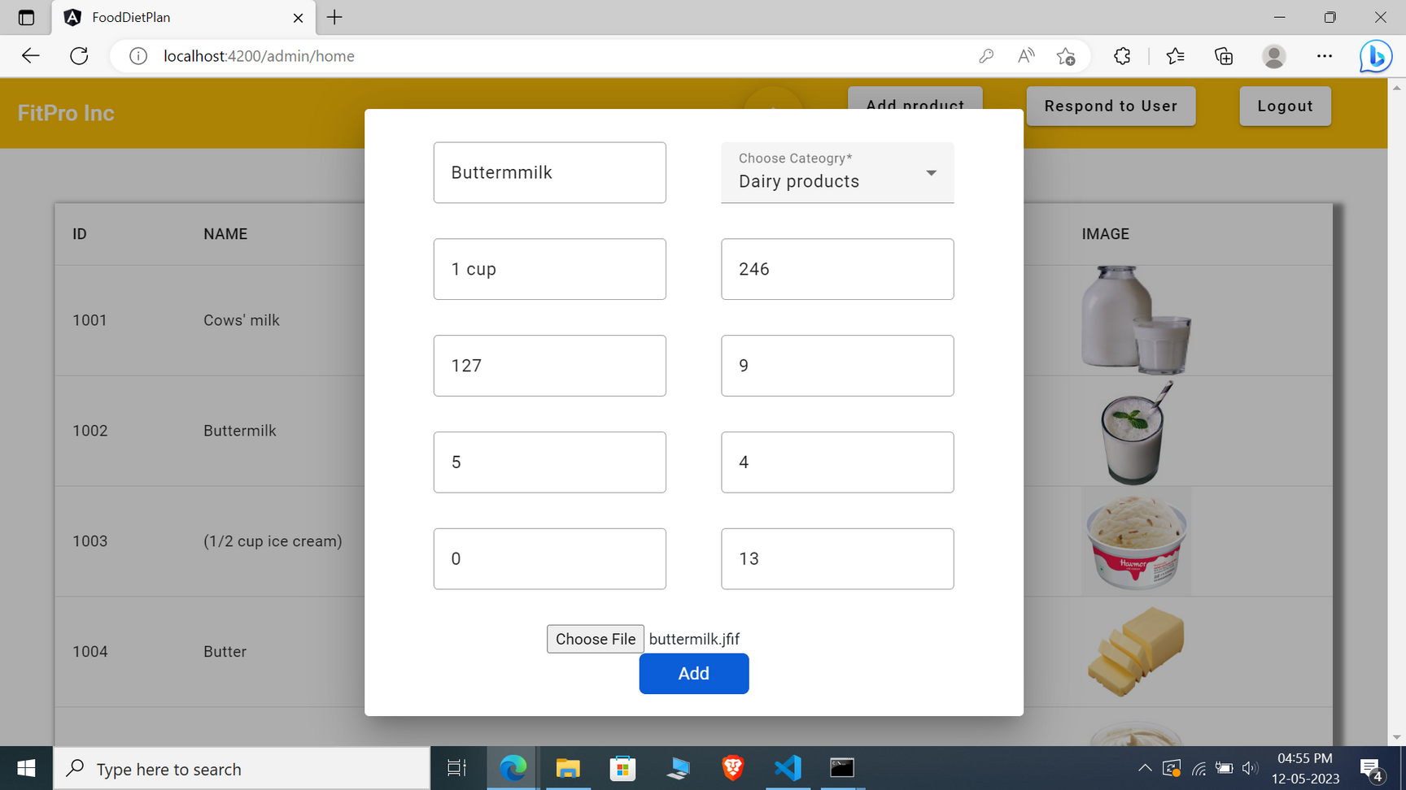
ADD PRODUCT

Slide 20
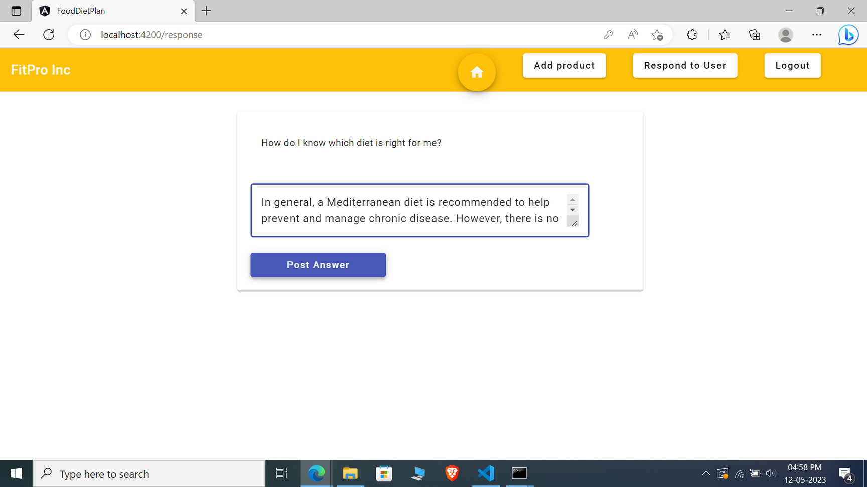
RESPOND TO USER
Admin responds to particular user's question

Slide 21
THANK YOU

